Slide 1

Domain: Data Security

Slide 2




Slide 3

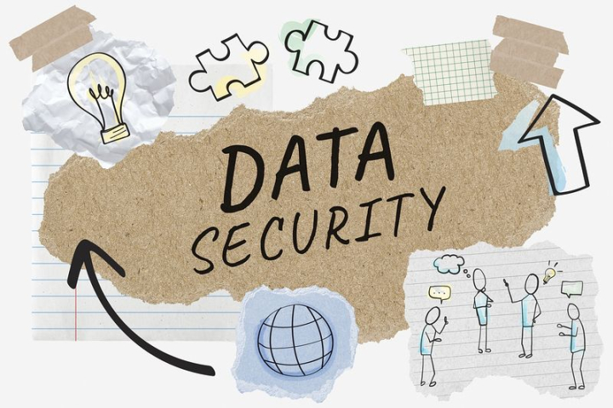
Data Security
Practice of protecting digital information from unauthorized access, corruption, or theft throughout its entire lifecycle.
It involves various methods for keeping the data confidential and safe. Like encryption, data masking, authentication etc.

Slide 4
Topic of interest : Ransomware & it’s mitigation

Slide 5

Ransomware
A malware that makes files on a victim’s computer accessible and then demands the victim to pay a ransom.[1]
‘Number on cyber threat’ facing Business in 2022, in a article by ZDNet.[2]
The global cost of it’s attacks is expected to reach $265 million by 2031 according to ‘Cybersecurity ventures’.

Slide 6
Problem Statement
A major security threat causing severe financial, operational damage and it’s is increasing despite of the growing awareness.
Not only financial losses but also lead to reputational damage, legal liabilities and loss of sensitive information.[3]
Due to COVID-19, organization had become more vulnerable.[3]

Slide 7
Problem Statement
Number of ransomware attacks increased by 64% in 2020 and mostly in healthcare sector.[3]
Recent attacks: Colonial Attacks, Kaseya attacks, attack on Irish health system.[2]
Requires a proactive and multidimensional approach which combines technical, organizational and legal measures.

